Slide 1


Slide 2
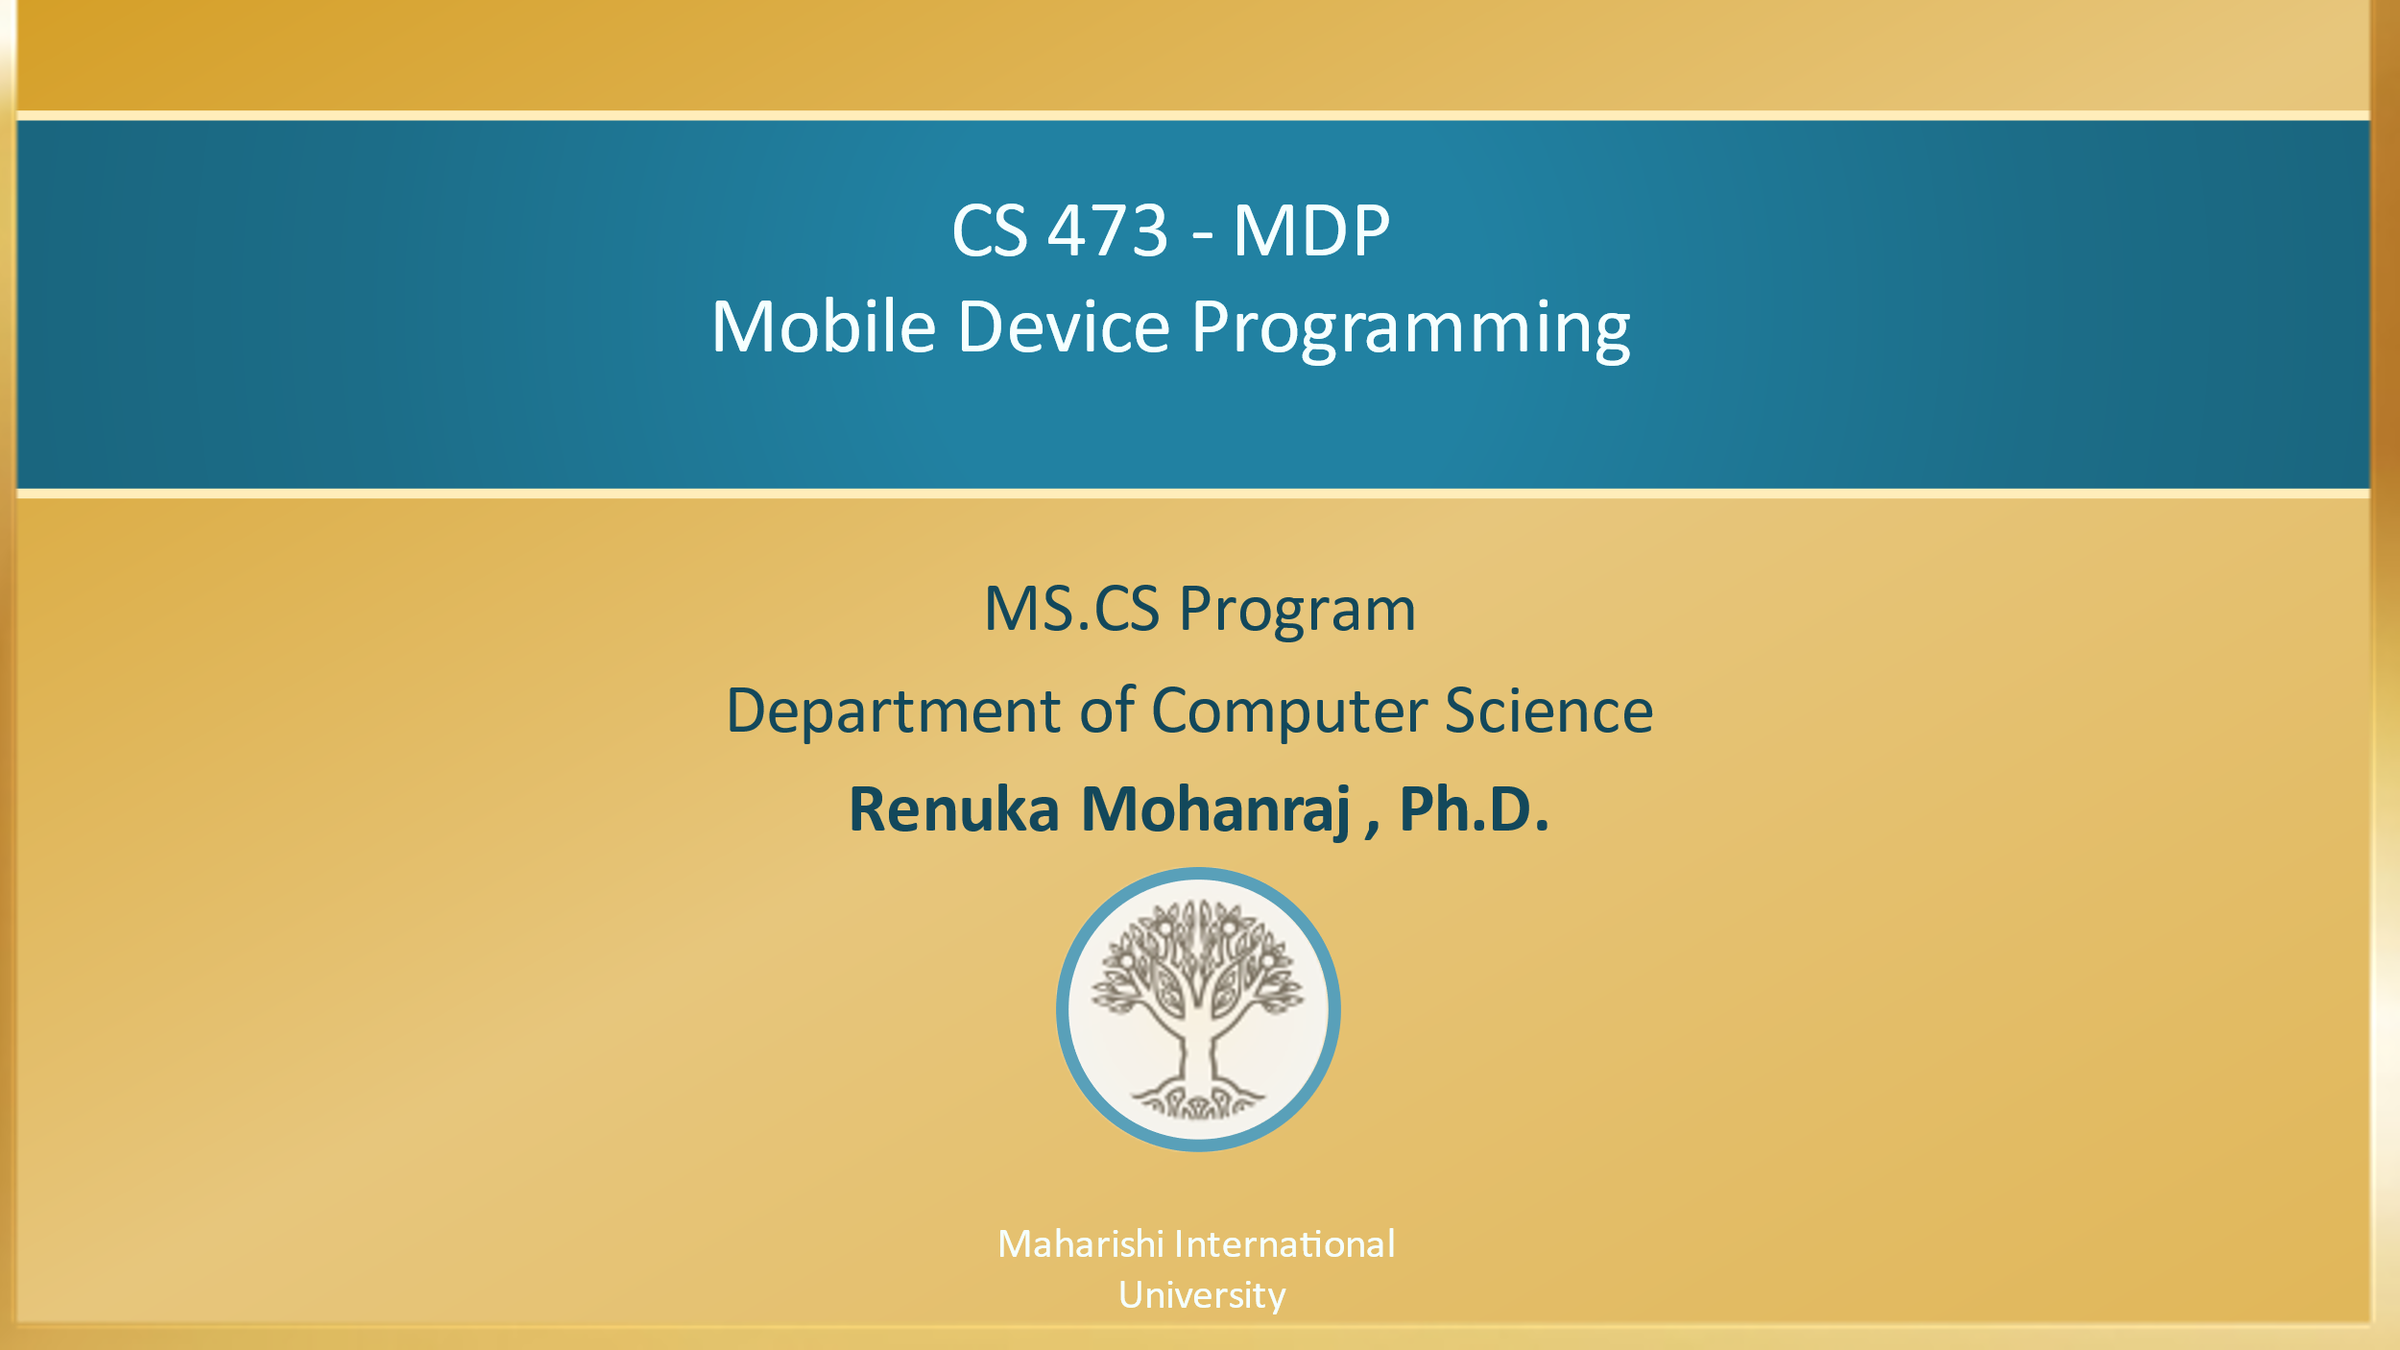

Slide 3

CS 473 – MDP
Mobile Device Programming
Lesson 8
WebView, Shared Preferences and JSON
Maharishi International
University

Slide 4
Wholeness of the lesson
WebView helps to displays web page. WebView class is the basis upon which you can roll your own web browser or simply display some online content within your Activity. The ultimate provider of tools for the creation of beautiful and functional content is pure intelligence itself; all creativity arises from this field’s self-interacting dynamics. How the android WebKit rendering engine to display web pages in this way when the knower’s awareness is permanently identified with the field of pure intelligence.

Slide 5
Contents
WebView
Introduction
WebView Operations
Hands on Example
Methods in WebViewClient class
SharedPreferences
Introduction
Applications of Shared Preferences
Steps for creating Shared Preferences
Retrieve, Update and Delete preferences
JSON, Gson
Internal Storage
Retrofit to read data from Network JSON data
Retrofit & Kotlin Coroutines

Slide 6
Introduction
WebView is one of the UI component in Android, which is used to display webpages in your application.
If you want to deliver a web application (or just a web page) as a part of a client application, you can do it using WebView
The WebView class is an extension of Android's View class that allows you to display web pages as a part of your activity layout.
Sample Scenario example : An Android app called MobikWik is a mobile recharge app, once you click on the Pay Now button, it will take the Bank Webpage.

Slide 7
Working with WebView
Adding the Widget : To add a WebView to your Application, simply include the <WebView> element in your activity layout.
<WebView android:id="@+id/webview"/>
Loading Content Via URL : To load a web page in the WebView, use loadUrl().
WebView myWebView = (WebView) findViewById(R.id.webview); myWebView.loadUrl("http://www.example.com");
However, we also must make one change to AndroidManifest.xml, adding a line where we request permission to access the Internet:
<uses-permission android:name="android.permission.INTERNET" />
Reading Resource : https://developer.android.com/guide/webapps/index.html

Slide 8
WebView Operations
By using Webview we can perform following operations.
Call & integrate browser(Using WebViewClient)
display .HTML files
we can provide a communication between HTML UI & Android Activity.

Slide 9
Hands on example-1
Problem : Type the expected URL in the EditText UI and click the search button to load the webpage in the WebView component. Below the WebView there are five Images to open the specified URL mostly preferred by the users. Click that image to load the web page in the WebView component.
Refer : Lesson8\WebViewTest

Slide 10
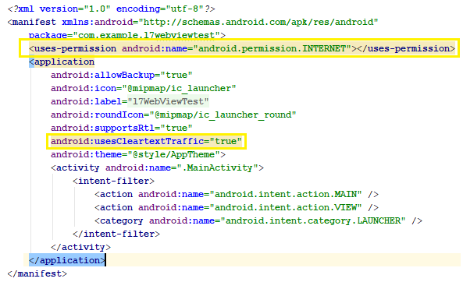
AndroidManifest.xml
Add the highlighted text in the AndroidManifest.xml to access internet user permission and usesClearTextTrffic:true to avoid url loading error

Slide 11
MainActivity.java
/*test method decide action based on the image view selected to load the Webpage in WebView UI*/
fun test(v:View) {
when (v.getId()) {
R.id.srch -> {
/* Load the EditText URL to the WebView UI, it is mendatory to mention http:// either here or at the runtime in EditText*/
wview.loadUrl("http://" + et1.getText().toString())
}
R.id.fb -> wview.loadUrl("http://facebook.com")
R.id.youtube -> wview.loadUrl("http://youtube.com")
R.id.google -> wview.loadUrl("http://google.com")
R.id.twitter -> wview.loadUrl("http://twitter.com")
} }

Slide 12
WebViewClient
Once you run the app if you click the facebook, youtube, google and twitter image, it will produce the following screen, because just we loaded the URL, but we didn’t integrate the browser.
Handling Page Navigation
When the user clicks a link from a web page in your WebView, the default behavior is for Android to launch an application that handles URLs.
Usually, the default web browser opens and loads the destination URL. However, you can override this behavior for your WebView, so links open within your WebView.
You can then allow the user to navigate backward and forward through their web page history that's maintained by your WebView.

Slide 13
WebViewClient
To open links clicked by the user, simply provide a WebViewClient for your WebView using setWebViewClient.
For example:
var myWebView = (WebView) findViewById(R.id.webview); myWebView.webViewClient = WebViewClient()

Slide 14
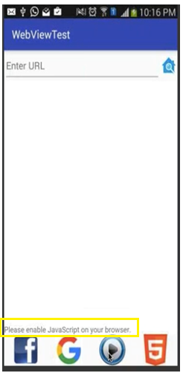
Supporting JavaScript
Now, you may be tempted to replace the URL with something else that relies upon JavaScript. You will find that such pages do not work especially well by default.(see the image).
That is because, by default, JavaScript is turned off in WebView widgets.
If you want to enable JavaScript, call the below method on the WebView instance.
wview.settings.javaScriptEnabled = true;
At this point, any JavaScript referenced by your Web page should work normally.
Sets whether the WebView should use its built-in zoom mechanisms.
The built-in zoom mechanisms comprise on-screen zoom controls, which are displayed over the WebView's content, and the use of a pinch gesture to control zooming. To enable by giving
wview.settings.builtInZoomControls = true;

Slide 15
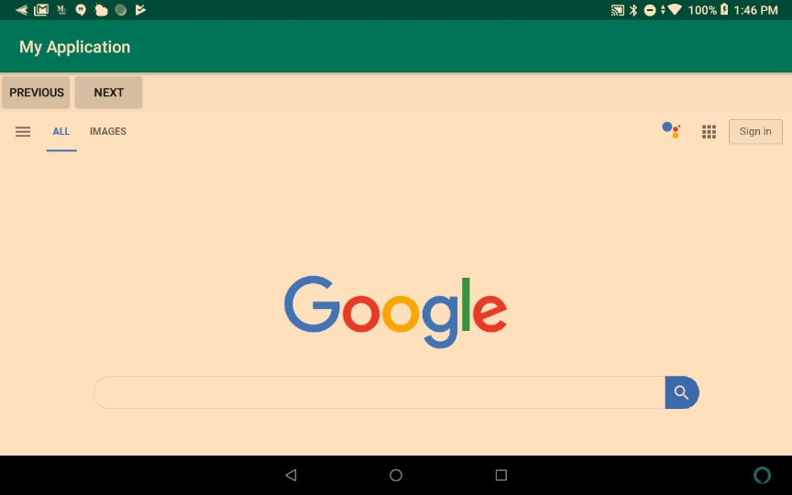
Hands on Example-2 - Navigation
The Screen load the url google.com.
You can browse through this url.
Click PREVIOUS and NEXT button to navigate.
If there is no previous and next webpages get a Toast no page available.
Refer : MyApplication

Slide 16
Methods in WebViewClient class
Create an Inner class with inherit from WebViewClient class, override the below methods according to your application requirements.
void onPageStarted () - Notify the host application that a page has started loading.
void onPageFinished () - Notify the host application that a page has finished loading.
For more information refer https://developer.android.com/guide/webapps/webview#kotlin

Slide 17
WebViewClient Methods
inner class MyWebClient : WebViewClient() {
// Page Loading started
override fun onPageStarted(view: WebView, url: String, favicon: Bitmap?) {
Toast.makeText(this@MainActivity,"Page Started",
Toast.LENGTH_LONG).show()
}
// Page Loading finished
override fun onPageFinished(view: WebView, url: String) {
Toast.makeText(this@MainActivity,
"PageFinished",Toast.LENGTH_LONG).show()
super.onPageFinished(view, url)
}
}

Slide 18
Navigating web page history
When your WebView overrides URL loading, it automatically accumulates a history of visited web pages.
You can navigate backward and forward through the history with goBack() and goForward().
The canGoBack() method returns true if there is web page history for the user to visit. Likewise, you can use canGoForward() to check whether there is a forward history. If you don't perform this check, then once the user reaches the end of the history, goBack() or goForward() does nothing.

Slide 19
MainActivity.java
override fun onCreate(savedInstanceState: Bundle?) {
super.onCreate(savedInstanceState)
setContentView(R.layout.activity_main)
url = "http://google.com"
webView.loadUrl(url)
webView.webViewClient = MyWebClient()
webView.settings.javaScriptEnabled = true
webView.settings.builtInZoomControls = true
btnprev!!.setOnClickListener {
if (webView.canGoBack()) {
webView.goBack() }
else{
Toast.makeText(this,"NO previous history available",Toast.LENGTH_LONG).show() } }
btnnext!!.setOnClickListener {
if (webView.canGoForward()) {
webView.goForward() }
else{
Toast.makeText(this,"NO back history available",Toast.LENGTH_LONG).show() }
}}

Slide 20
Main Point 1
Useful methods in WebViewClent class are onPageStatred() and onPageFinished() helps to perform something when the page is started, new Url is loaded and the page has finished loading. Science of Consciousness: Similarly, we start TM by closing eyes, then start thinking Mandra, allow thoughts to come and go along with the mantra for twenty minutes and slowly come out by taking 2-3 minutes of silent to finish meditation.

Slide 21
Shared Preferences

Slide 22
Introduction
Android provides several options for you to save your app data:
Shared Preferences: Store data as key-value pairs.
Internal Storage: Store data on the device memory. Data will not be accessed by other application.
External Storage: Store files on the shared external file system. This is usually for shared user files, such as photos. (SD Card)
SQLite Databases(Room): Store structured data in a private database.
Network Connection: Store data on the Web with your own network server.
Refer about storage : https://developer.android.com/guide/topics/data/data-storage.html

Slide 23
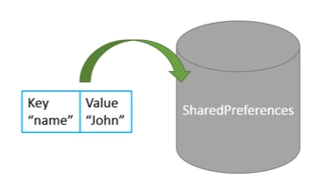
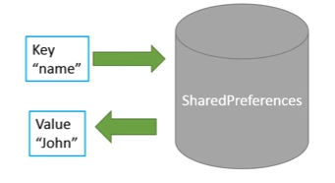
SharedPreferences
Android provides SharedPreferences object to help the developer to save simple application data.
Using the SharedPreferences object, the developer can save and retrieve the desired data using key/value pairs.

Slide 24
SharedPreferences
The developer needs to specify a key for the data that is required to be saved, and then both the key and its value will be saved automatically to an XML file.
It enables the developer to save primitive data types such as boolean, float, long, string, and so on.
The SharedPreferences class is present in the android.content package and the developer needs to import the class to work with an object of the class.

Slide 25
Applications of SharedPreferences
Last data user entered in your application
Store the last updates of date and time
Credentials – Remember user details like username and password
Location catching – Identify the last location
Store the login pattern
Game’s high score and current level.

Slide 26
Steps for creating SharedPreferences
Step 1 : Obtain the Shared Preference object by calling getSharedPreferences().
val prefs = getSharedPreferences(prefName, MODE_PRIVATE)
Parameters :
prefName : name of the preference file as String
mode : operating file creation mode as int.
That is MODE_PRIVATE(takes o – Zero)
Step 2 : We need an editor object to make changes which is SheredPreferences.Editior.
This is done by invoking the edit() method on the object of the SharedPreferences class as shown
val editor = prefs.edit()
Notes:
If your app needs to share private files with other apps, it may use a FileProvider with the FLAG_GRANT_READ_URI_PERMISSION. For more information, also see Sharing Files.
Difference between getPreferences() and getSharedPreferences(): https://developer.android.com/training/data-storage/shared-preferences

Slide 27
Step 3 : Next, the developer can add key/value pairs to the Editor object by invoking its various methods such as putBoolean(), putString(), putLong(), putInt(), or putFloat()(which method to use depends on the type of data that is being saved) as shown below
editor.putString("username", "RenukaMohanraj")
editor.putBoolean(“authenticated”, true)
We stored 2 key-value pairs. This is how your MyPrefs.xml should look s like :
<?xml version='1.0' encoding='utf-8' standalone='yes' ?>
<map>
<string name="username">RenukaMohanraj</string>
<boolean name="authenticated"> value="true" />
</map>
Step 4 : Finally, the apply() method of the Editor class is invoked to commit the changes back to the SharedPreferences object so that the values can be saved to persistent storage.
editor.apply();
If you want send as Object to Shared Preferences make use of JSON.

Slide 28
Retrieving Preferences
Fetching the preferences is done directly on the SharedPreferences object.
So SharedPreferences.Editor is not required.
There are several get methods for this job like getBoolean(), getFloat(), getInt(), getLong(), and getString().
All of them accept two arguments where the first is the name of the key while the second non-optional one is the default value to return if the preference does not exist (is undefined).
val prefs = getSharedPreferences("MyPrefs", Context.MODE_PRIVATE)
val username = prefs.getString("username", "")
val logged_in = prefs.getBoolean("logged_in", false)
Notes:
Android Studio includes a debugging tool called the Dalvik Debug Monitor Server(DDMS), which provides port-forwarding services, screen capture on the device, thread and heap information on the device, logcat, process, and radio state information, incoming call and SMS spoofing, location data spoofing, and more.

Slide 29
Updating Preferences
Updating the preferences is similar to the setting them that we just learnt a bit back.
Get the SharedPreferences.Editor object, set values using the put*() methods and then commit your changes.
val pref = getSharedPreferences("MyPrefs", Context.MODE_PRIVATE)
// We need an editor object to make changes
val edit = prefs.edit();
// Modify the Stored data
edit.putString("username", “Renuka")
edit.putBoolean("logged_in", false)
// Commit the changes
edit.apply()
Notes:
Android Studio includes a debugging tool called the Dalvik Debug Monitor Server(DDMS), which provides port-forwarding services, screen capture on the device, thread and heap information on the device, logcat, process, and radio state information, incoming call and SMS spoofing, location data spoofing, and more.

Slide 30
Deleting Preferences & Contains check
Deleting a particular preference is very simple. Just call the remove() method and commit your changes.
// Remove a key
prefs.remove("username")
// Commit changes
prefs.apply()
You can check the exists or not by using the contains method on your SharedPreferences instance:
// Check the key exist or not
boolean hasUser = preference.contains("username")
Notes:
Android Studio includes a debugging tool called the Dalvik Debug Monitor Server(DDMS), which provides port-forwarding services, screen capture on the device, thread and heap information on the device, logcat, process, and radio state information, incoming call and SMS spoofing, location data spoofing, and more.

Slide 31

Where Shared preference data goes?
Internally SPF will maintain the data in an XML file, we can explore the SharedPreferences xml file using Android Studio Devise File Explorer
Click View → Tool Windows → Device File Explorer or click the Device File Explorer button in the tool window bar to open the Device File Explorer.
The file will be saved under your emulator directory data/data/<application_packagename>/shared preference folder.
For more information to view the shared preference persisted data:
Refer the Lesson8 SPF Step by Step View Persisted data.pdf

Slide 32
By using SharedPreferences, we can not maintain huge amount of data , but for every value we must give a unique key its difficult to remember & assign new keys for every value , that’s why SharedPreferences is preferred to maintain the limited amount of data.
If you want to maintain huge amount of data, Android is preferred to use Local Databases.

Slide 33
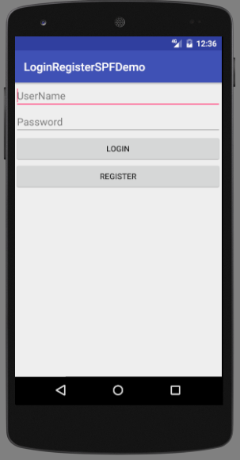
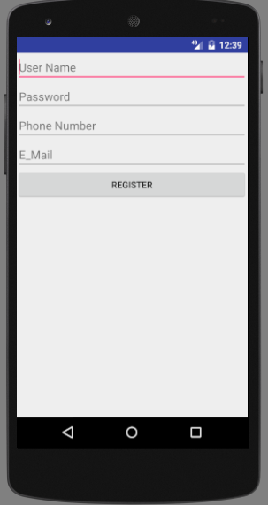

Hands-on-Examples
Problem Requirement : Design an application which preform, if the user already exists, they can directly click the Login button else by clicking Register button to register the information. Here we are using SharedPreferences to store the information of the last registered user.
Refer : SPFLoginRegister
activity_main.xml
activity_register.xml

Slide 34
MainActivity.kt
class MainActivity : AppCompatActivity() {
lateinit var spf:SharedPreferences
override fun onCreate(savedInstanceState: Bundle?) {
super.onCreate(savedInstanceState)
setContentView(R.layout.activity_main)
spf = getSharedPreferences("login", Context.MODE_PRIVATE)
// key, value pair. Here by default name is not found assign " no value"
val name = spf.getString("name", "no value")
val pwd = spf.getString("pass", "no value")
et1.setText(name)
et2.setText(pwd)
}

Slide 35
MainActivity.kt
// Check whether the user exist already in the SharedPreferences.
fun login(view: View) {
// To get the SharedPreferences using its name
// SharedPreferences spf = getSharedPreferences("login", Context.MODE_PRIVATE);
// key, value pair. Here by default name is not found assign " no value"
val name = spf.getString("name", "no value")
val pwd = spf.getString("pass", "no value")
if ((et1.text.toString().equals(name,ignoreCase = true) && et2.getText().toString().equals(pwd))){
Toast.makeText(getApplicationContext(), "Success", Toast.LENGTH_LONG).show() }
else{
Toast.makeText(getApplicationContext(), "Fail to Login", Toast.LENGTH_LONG).show() } }
fun register(view:View) {
// We are navigating through to the RegisterActivty from ManinActivity using Intent
val i = Intent(this, RegisterActivity::class.java)
startActivity(i)
}}

Slide 36
RegisterActivity.kt
class RegisterActivity : AppCompatActivity() {
override fun onCreate(savedInstanceState: Bundle?) {
super.onCreate(savedInstanceState)
setContentView(R.layout.activity_register)
}
fun register(view: View) {
// Create and Read the SharedPreferences
val spf = getSharedPreferences("login", Context.MODE_PRIVATE)
// To write a data using SharedPreferences Object
val spe = spf.edit()
// Using put method to write the data in SharedPreferences
spe.putString("name", et1.text.toString())
spe.putString("pass", et2.text.toString())
spe.putString("phone", et3.text.toString())
spe.putString("email", et4.text.toString())
spe.apply()
Toast.makeText(this, "Registered", Toast.LENGTH_LONG).show()
// Once finished writing we need to go back to the main activity to show the Login
finish() // automatically destroy the activity and give the visibility of Main Activity
}
}
Register this activity in AndriodManifest.xml
<activity android:name=".RegisterActivity"></activity>

Slide 37
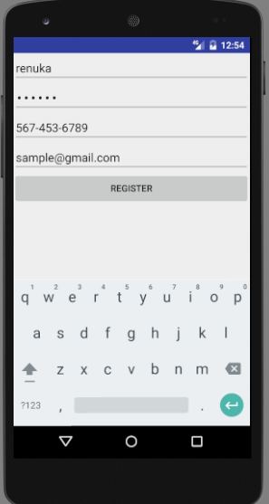
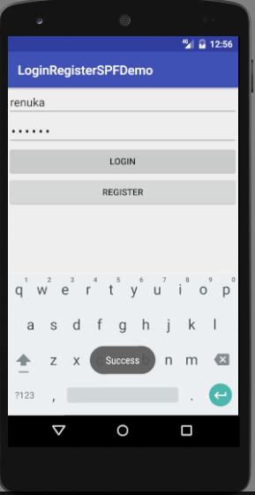
Run the Code

Slide 38
Demo Folder
LoginRegisterSPF
SharedPreferencesDemo

Slide 39
Main Point 2
Android provides SharedPreferences object to help the developer to save and retrieve simple application data through the use of key/value pairs. Science of Consciousness: Transcendental Consciousness provides simple and useful foundation for developing any skill, because regular experience of this field stimulates the flow of thought and action from the total potential of our creativity and intelligence.

Slide 40
JSON
JSON stands for JavaScript Object Notation. It is an independent data exchange format and is the best alternative for XML.
A modifiable set of name/value mappings. Names are unique, non-null strings. Values may be any mix of JSONObjects, JSONArrays, Strings, Booleans, Integers, Longs, Doubles. Values may not be null.
It is easy for machines to parse and generate ( for more info : www.json.org)
JSON object represented using { } braces. JSON arrays represented using [ ] braces.

Slide 41
XML & JSON Format of Employee record
JSON Format
XML Format
<employees>
<employee>
<id> 123 </id>
<name> Renuka </name>
<desig> AP </desig>
<dept> CS </dept>
</employee>
<employee>
<id> 125 </id>
<name> Mohanraj </name>
<desig> GD </desig>
<dept> CS </dept>
</employee>
</employees>
{“employees”:[
{
“id” : 123,
“name”: “Renuka”,
“desig” : “AP”,
“dept”:”CS”
},
{
“id” : 125,
“name”: “Mohanraj”,
“desig” : “GD”,
“dept”:”CS”
}
]}

Slide 42
XML vs JSON
Both are used to transfer data from one technology to another technology.
JSON occupies less space and load faster than XML.
Information is represented as a collection of key/value pairs, and that each key/value pair is grouped into an ordered list of objects. JSON can provide data type like Integer, String.
“id” : 123
“name”: “Renuka”
JSON parsing is simple. Converting object to JSON and JSON to object.
Android has a build-in support for JSON parsing.
Third party libraries are available in the market for paring such as GSON, Retrofit, Jackson & Jettison etc.
In this course we will use GSONS and Retrofit.

Slide 43
Google Gson (Gson)
Gson is a Java library that can be used to convert Java(POJO)/Kotlin(POKO) Objects into their JSON representation.
POJO – Plain Old Java Object, POKO – Plain Old Kotlin Object
It can also be used to convert a JSON string to an equivalent Java/Kotlin object.
It has extensive support for generics.
Provide simple toJson() and fromJson() methods to convert Java/Kotlin objects to JSON and vice-versa.
To use Gson in Android add the below dependencies add directly in the gradle Module:app or follow the next few slides to add dependency.
implementation 'com.google.code.gson:gson:2.9.1'
Square’s Retrofit, including its Gson-based converter code, for retrieving JSON data from Web services.

Slide 44
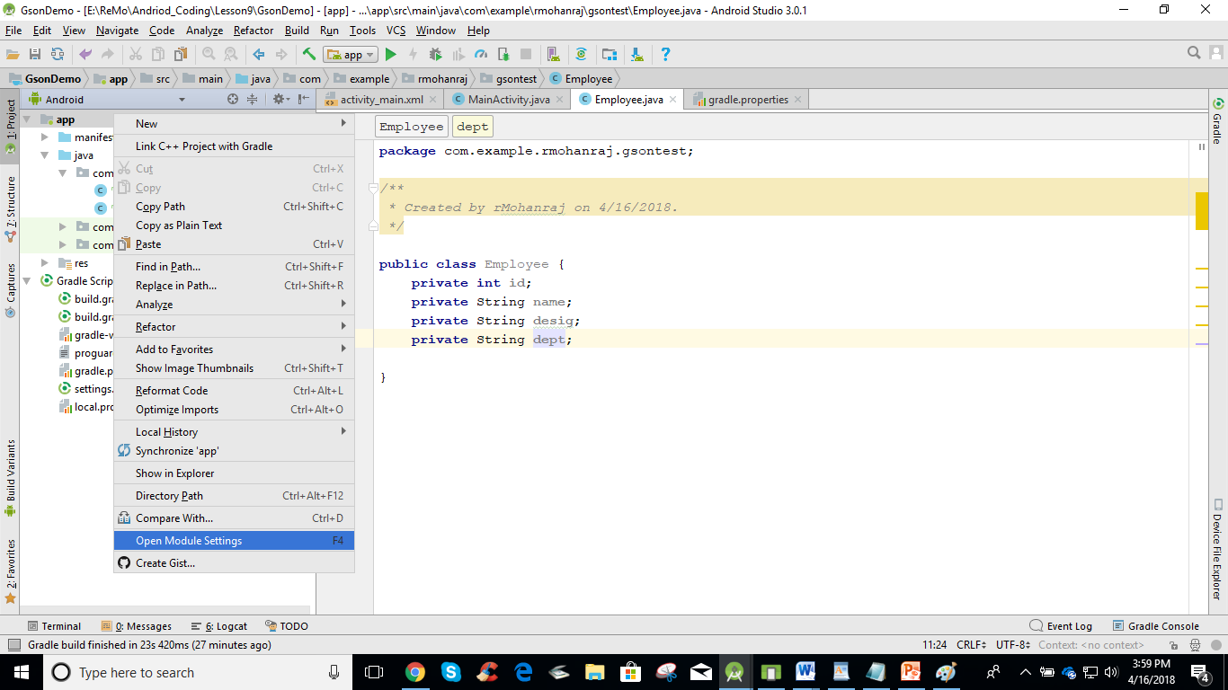
Add Gson dependencies
Step 1 : Right click app-> Open Module Settings

Slide 45
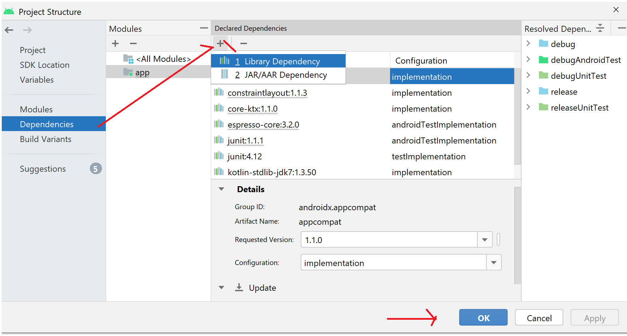
Add Gson dependencies
Step 2 : Choose the Dependencies Tab and click + icon to add dependency by selecting Library Dependencies

Slide 46
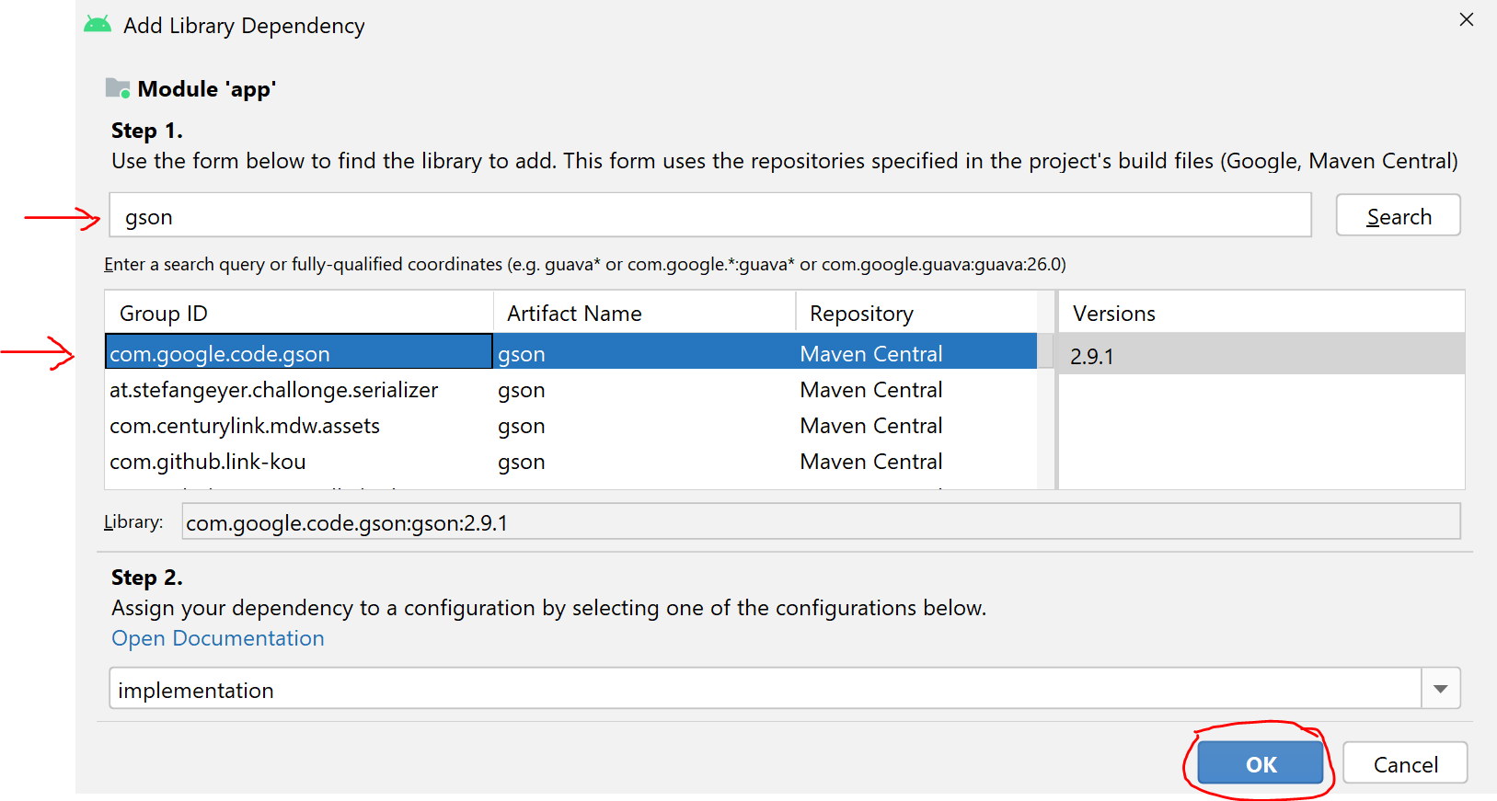
Add Gson dependencies
Step 3 : Search gson dependency and select the highlighted dependency and click ok will automatically add implementation 'com.google.code.gson:gson:2.9.1' on Gradle.

Slide 47
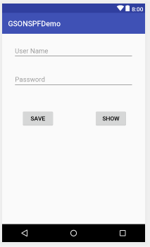
Hands on Example using Gson
Here Username and Password stored as a User Object.
Using Gson, object is stored and retrieved on Shared Preferences.
Once the user select the SAVE button, data will be stored into Shared Preference.
Once the user select the SHOW button, data will be retrieved from Shared Preference.
Refer : Lesson9\GSONSPFDemo

Slide 48
User.java
data class User(val uname:String, val password:String)

Slide 49
MainActivity.java
// This demonstrates to insert User object into Shared Preferences using GSON fun save(view: View) {
// Create Gson obeject to store into Shared Preferences
val gson = Gson()
val name =et1.getText().toString()
val pass = et2.getText().toString()
// Get the Input from the Edit text and make an User Object
val ob = User(name, pass)
if (ob != null){
// Convert User object into String object using toJson() method
val first = gson.toJson(ob)

Slide 50
MainActivity.java
// Store the retrieved Sting into Shared Preferences
// 0 indicates MODE_PRIVATE
val spf = getSharedPreferences("user", 0)
val edit = spf.edit()
edit.putString("data", first)
edit.apply()
Toast.makeText(getApplicationContext(), "Success", Toast.LENGTH_LONG).show()
}
else {
Toast.makeText(getApplicationContext(), "Failure", Toast.LENGTH_LONG).show()
}
et1.setText("")
et2.setText("")
}

Slide 51
fun show(view:View) {
// Create Gson obeject to retrieve data from Shared Preferences
val gson = Gson()
val spf = getSharedPreferences("user", 0) //0->MODE_PRIVATE
val res = spf.getString("data", "")
/* Convert the String object into User object using
fromJson() method, return a type of User*/
val opt = gson.fromJson(res, User::class.java)
if (opt != null){
et1.setText(opt.uname)
et2.setText(opt.password)
}
else{
Toast.makeText(getApplicationContext(), "Failure to retrieve", Toast.LENGTH_LONG).show()
}
}

Slide 52
Main Point 3
JSON has become more widely used for data representations than XML because JSON is easier to write and read and is almost identical to Java object literal syntax. Gson is a Java library to convert Kotlin Objects into their JSON representation. Science of Consciousness: Enjoy greater efficiency and accomplish more by using JSON android APIs.

Slide 53
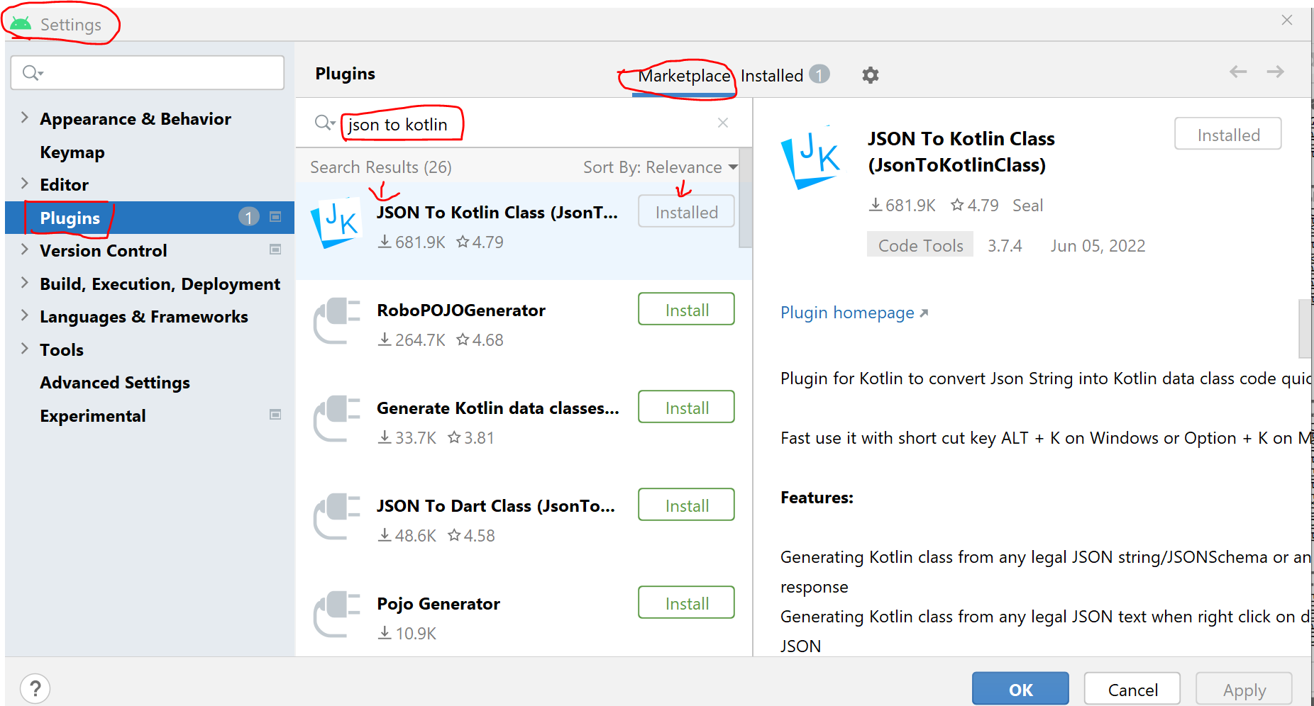
JSON data into Kotlin data class
Go to File→Settings→ Plugins

Slide 54
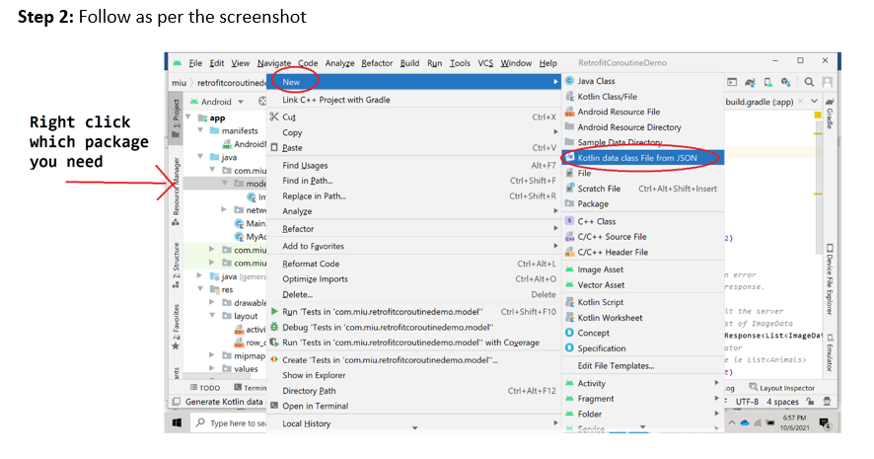
JSON data into Kotlin data class

Slide 55
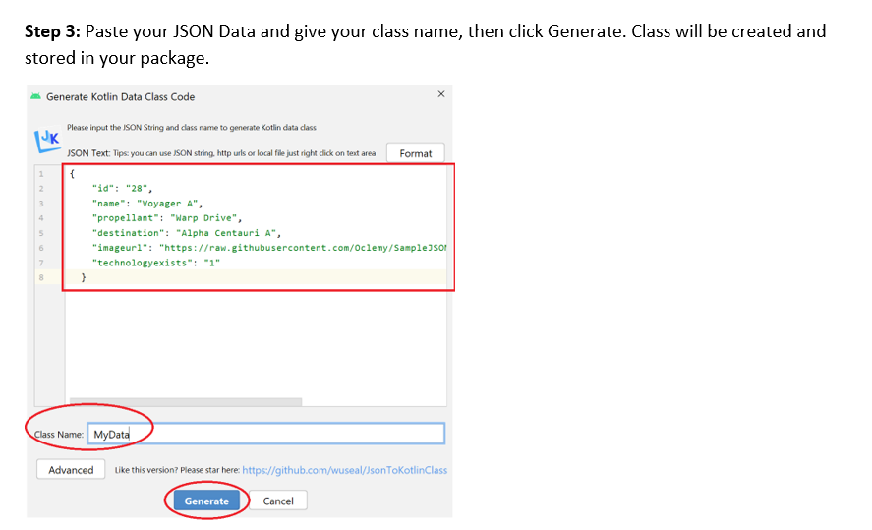
JSON data into Kotlin data class

Slide 56
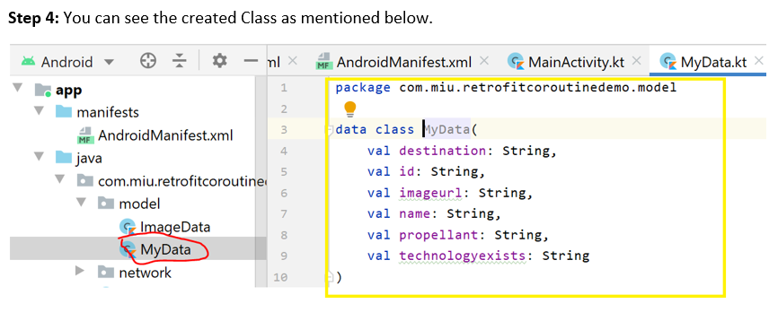
JSON data into Kotlin data class

Slide 57
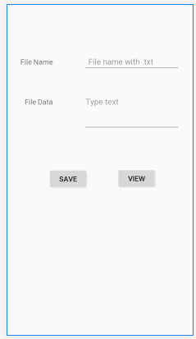
Hands on Example - File Read and Write Internal Storage
Refer InternalStorageDemo
Give a Filename and type the multiple lines of text data.
Click the SAVE button to store on the device Internal storage.
Give the filename to view and Click VIEW to retrieve the data from the file which displayed on the File data UI.
To see the files from Internal storage,
Click View → Tools Window→ Device File Explorer
Select the Device you installed
Click data → data→ goto the right package → files

Slide 58
Retrofit
Two Web Services
SOAP stands for Simple Object Access Protocol.
REST stands for REpresentational State Transfer
Most popular Webservice is Retrofit(REST) . It’s a REST Client for Java and Android. It makes it relatively easy to retrieve and upload JSON (or other structured data) via a REST based webservice. Developed by Square(Third party Library).
In Retrofit you should configure which converter is used for the data serialization.(like JSON, Gson)
Retrofit automatically serializes and desterilizes the JSON data as a type of POJO/POKO
Best Example for WebService : Finding places using Google Maps
Read more about from : https://square.github.io/retrofit/
Notes:
Old Library – AysnTask, Volley.
Retrofit – Works Faster to retrieve the response.

Slide 59
Hands on Example
Problem Requirement : Read the JSON Data from this url: https://raw.githubusercontent.com/Oclemy/SampleJSON/338d9585/spacecrafts.json using Retrofit Library and show the data in the Recycler GridView
Need to add the following dependencies in build.gradle (Module:app)
// Retrofit and the Gson converter dependency
implementation 'com.squareup.retrofit2:retrofit:2.6.0'
implementation 'com.squareup.retrofit2:converter-gson:2.6.0'
// Glide support for Image downloading from the third party
implementation 'com.github.bumptech.glide:glide:4.8.0'
// Add permission in your Manifest
<uses-permission android:name="android.permission.INTERNET"></uses-permission>

Slide 60
Steps to follow
Add Dependencies to the app-module build.gradle file:
Design an UI to retrieve network data probably ListView, GridView and RecyclerView
Create Data Class
Create the API interface which we will use to make requests and get responses via retrofit. [ Other requests – Post, Delete etc.,]
Create a Client call to get the response from the url using Retrofit object.
val api = Retrofit.Builder()
.baseUrl(base_url)
.addConverterFactory(GsonConverterFactory.create())
.build()
.create(APIInterface::class.java)

Slide 61
Steps to follow
// To get the methods automatically press CTRL + SHIFT +Space key, inside enqueue.
6.Then call enqueue() and override the following two methods to retrieve the data into your view object.
override fun onResponse(call: Call<List<POKO Type>?>?, response: Response<List<POJO Type>?>?) {
if( response!!.isSuccessful){ // Check using non null !! operator
/*The deserialized response body of a successful response and set into your adapter */
}
}
call.enqueue(object : Callback<List< POKO Type >> {
override fun onFailure(call: Call<List< POKO Type >?>?, t: Throwable?) {
// The localized description of this throwable, like getErrorMessage from throwable
Toast.makeText(applicationContext,"An Error Occured ${t?.localizedMessage}",Toast.LENGTH_LONG).show()
}
})

Slide 62
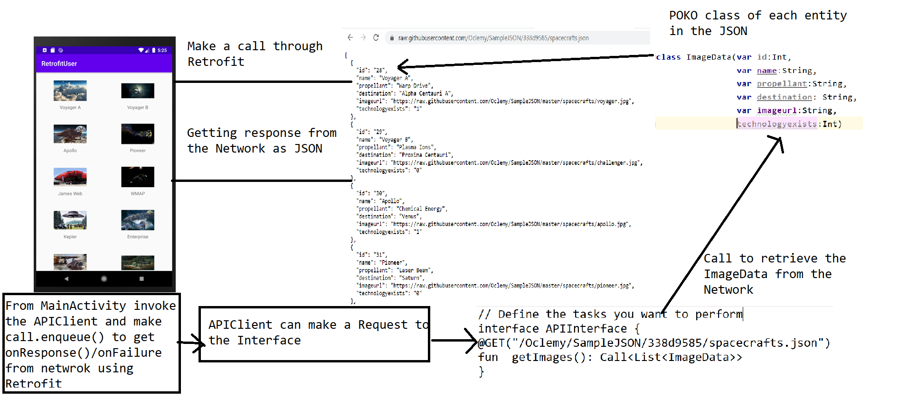
Complete Picture of the Implementation

Slide 63
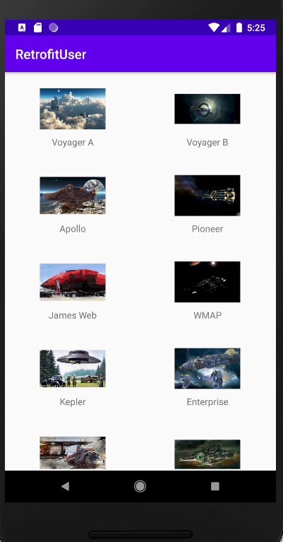
Expected Outcome
Read image data from the given URL JSON data and displayed in the GridView.
Refer Demo: RetrofitRecyclerView
Workflow
Client Request → send through Retrofit → Network Server
Network Server→ Send responses in JSON Format → Response converted using GSON into object format → retrieve as POJO/POKO Type

Slide 64
Kotlin Coroutines
Why Coroutines
In Android, it's essential to avoid blocking the main thread.
The main thread is a single thread that handles all updates to the UI.
It's also the thread that calls all click handlers and other UI callbacks.
As such, it must run smoothly to guarantee a great user experience.
The recommended way of managing background threads that can simplify code by reducing the need for callbacks.
Coroutines are a Kotlin feature that converts async callbacks for long-running tasks, such as database or network access.
Kotlin coroutines let you convert callback-based code to sequential code and keeps Main safe.
Dependency: implementation("org.jetbrains.kotlinx:kotlinx-coroutines-android:1.6.1")
Notes:
Asynchronous callbacks are functions passed to another function that starts executing code in the background.

Slide 65
Coroutine Terminology
Coroutine Scope: (Interface)
Defines a scope for new coroutines. Every coroutine builder (like launch, async, etc) is an extension on CoroutineScope and inherits its coroutineContext to automatically propagate all its elements and cancellation. Types of Scope are Global, Life Cycle and View Model.
A global CoroutineScope not bound to any job. Global scope is used to launch top-level coroutines which are operating on the whole application lifetime and are not cancelled prematurely.
launch is a function that creates a coroutine and dispatches the execution of its function body to the corresponding dispatcher.

Slide 66
Coroutine Terminology
Dispathers
Kotlin coroutines use dispatchers to determine which threads are used for coroutine execution.
Dispatchers.Main - Use this dispatcher to run a coroutine on the main Android thread. This should be used only for interacting with the UI and performing quick work.
Dispatchers.IO - This dispatcher is optimized to perform disk or network I/O outside of the main thread.
Dispatchers.Default - This dispatcher is optimized to perform CPU-intensive work outside of the main thread.
suspend keyword enforce a function to be called from within a coroutine or another suspend function. The biggest merit of coroutines is that they can suspend without blocking a thread.

Slide 67
Modified Retrofit Example
GlobalScope.launch(Dispatchers.Main) {
val response = api.getImages()
if( response!!.isSuccessful){ // Check using non null !! operator
response.body().let {
if (it != null) {
myAdapter = MyAdapter(it,applicationContext)
recyclerView1.adapter = myAdapter
}
}
}
else {
Toast.makeText(applicationContext,"Failed to Retrieve
",Toast.LENGTH_LONG).show()
}
}
let is a Kotlin Scope function, can make your code more concise and readable.
Refer : RetrofitCoroutineScope

Slide 68
